Slide 1
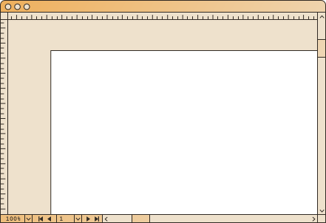

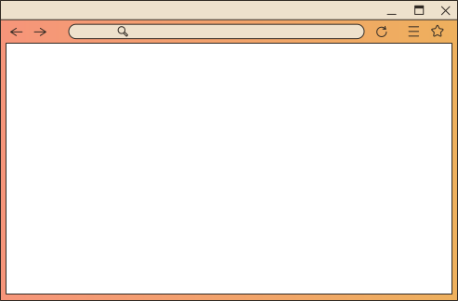

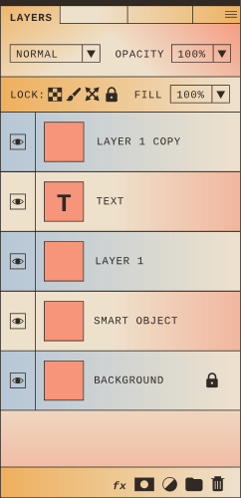

E-COMMERCE
E-Commerce Website
Built with HTML, CSS, JavaScript, and Angular

Slide 2

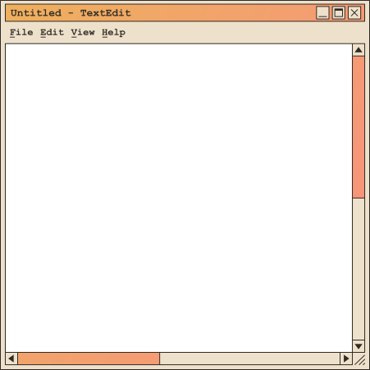

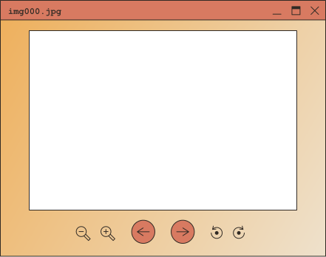

Overview
Shoppers is a fully responsive eCommerce platform designed to provide a seamless shopping experience across categories for men, women, and children. It was built using a combination of HTML, CSS, JavaScript, and Angular.
Tip: Use links to go to a different page inside your presentation.
How: Highlight text, click on the link symbol on the toolbar, and select the page in your presentation you want to connect.

Slide 3
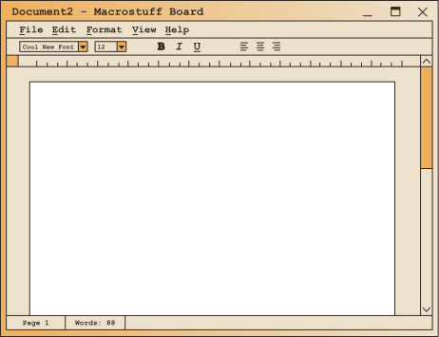

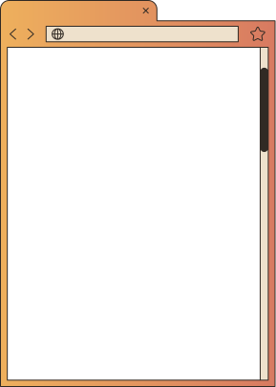
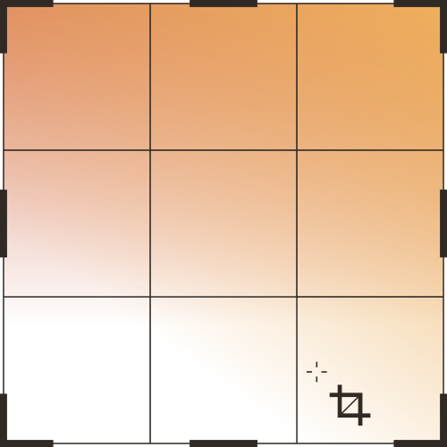
Technologies Used
Bootstrap
Angular
Responsive design techniques
HTML
CSS
JavaScript
Back to Agenda Page

Slide 4
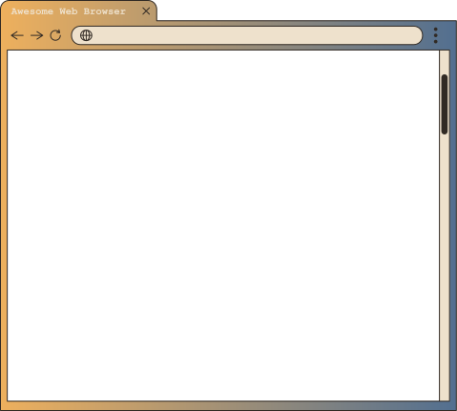
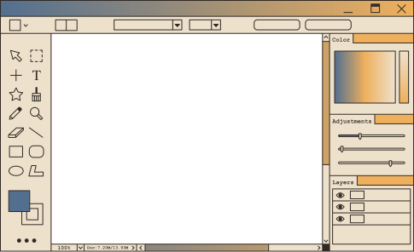


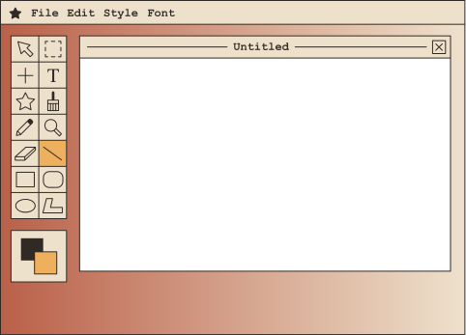
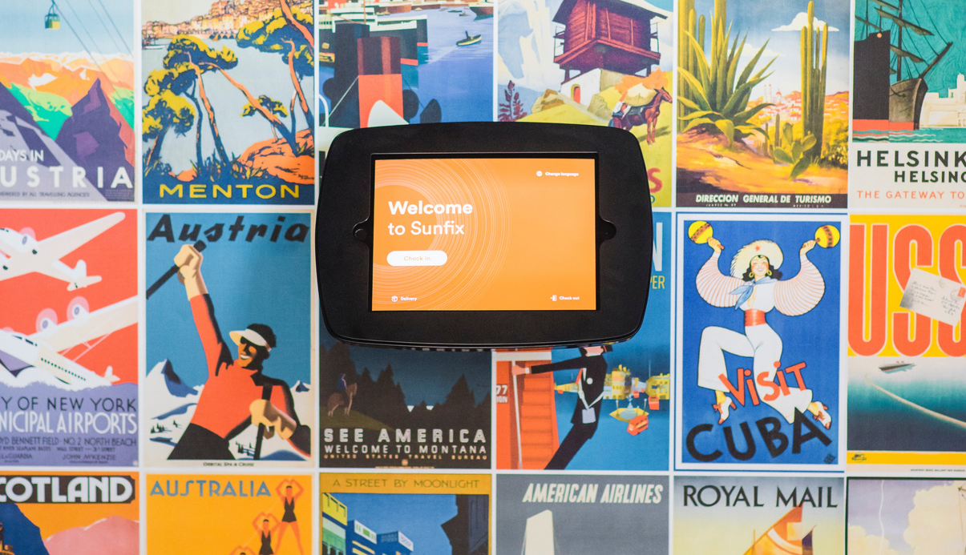
Cart: View selected items
Product Details: Detailed description of each product
Shop Section: Browsing products by category
Contact Us Page
Categories: Men, Women, Child
Wishlist: Save items for later
Features Overview

Slide 5
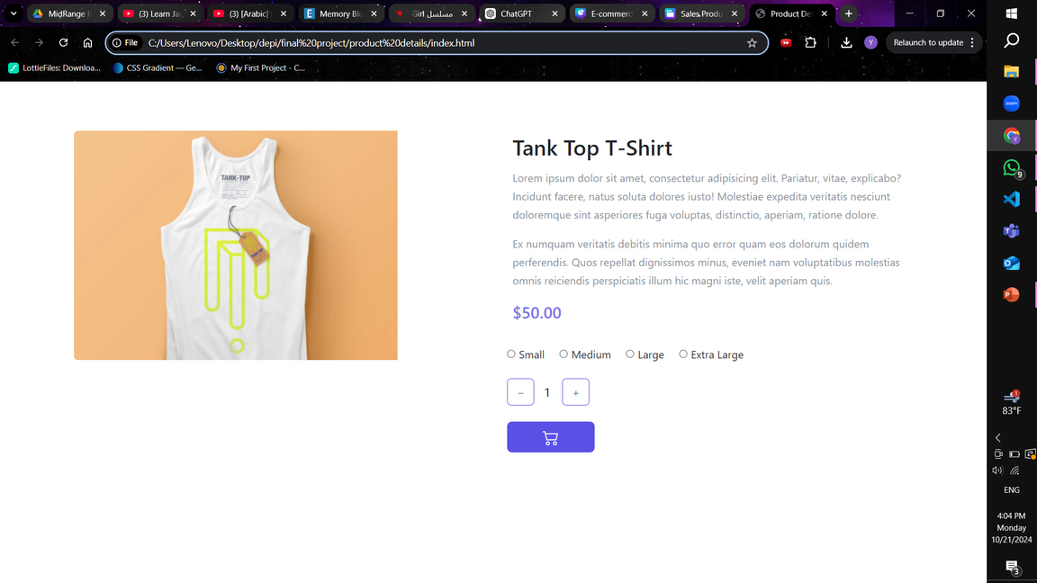
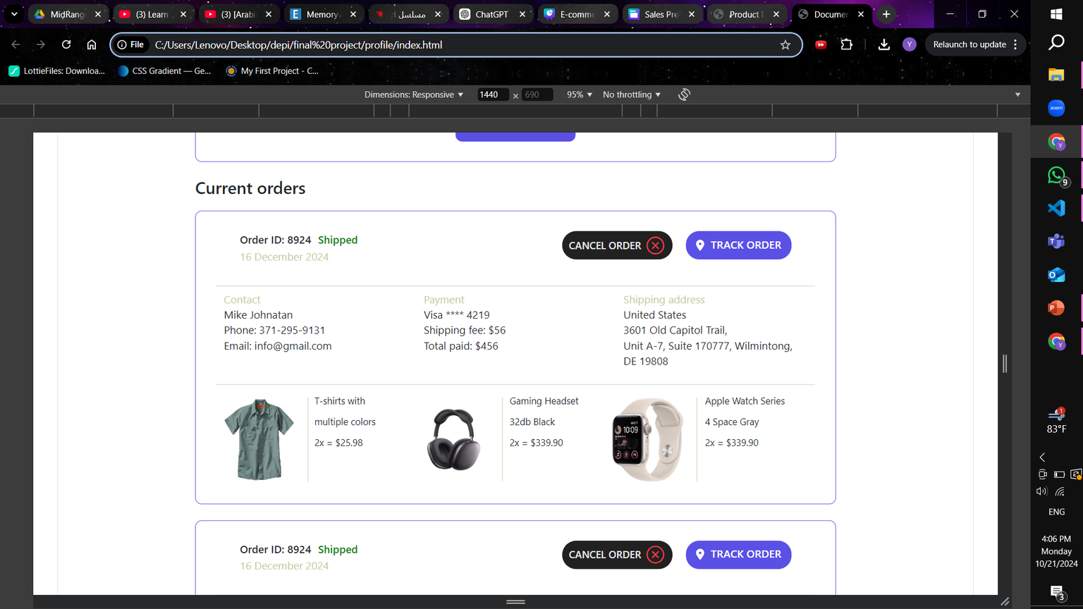
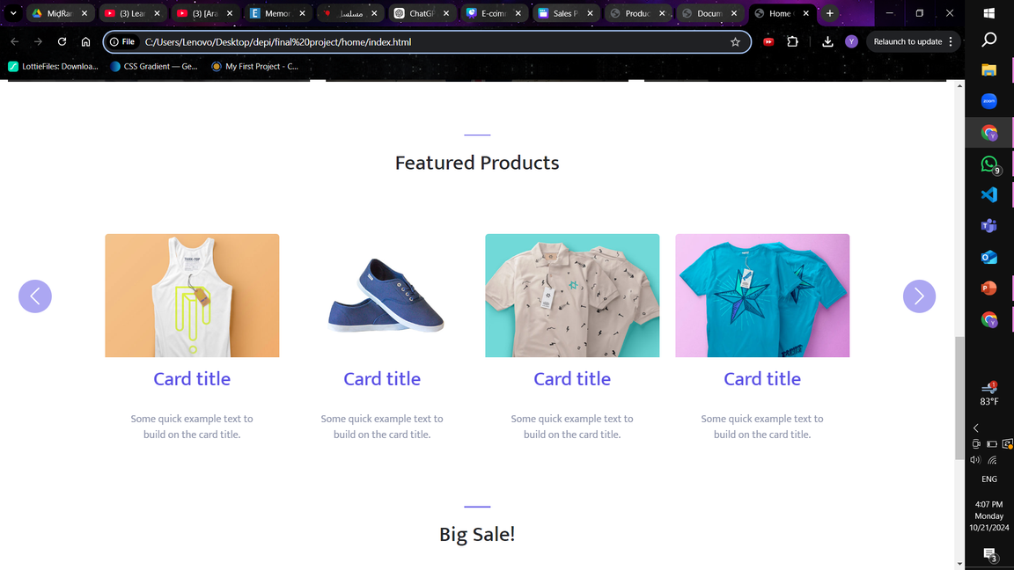
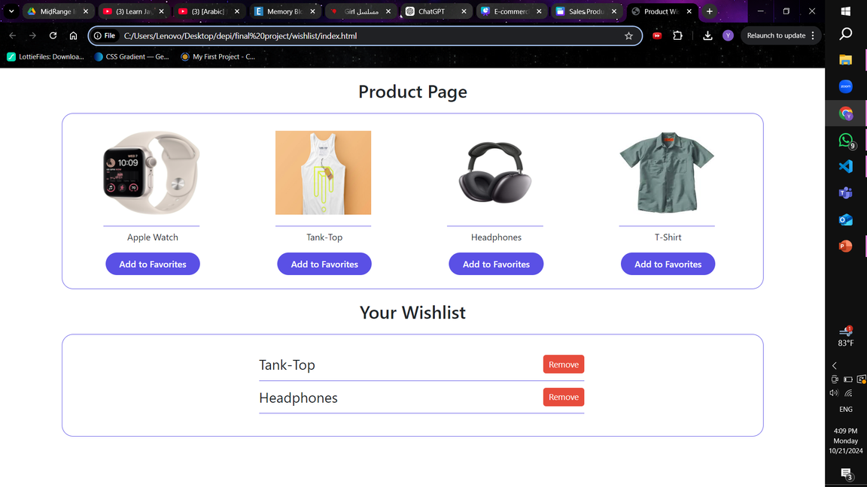
User Interface (UI)
Responsive Design

Slide 6
Functionalities
Add items to the cart.
Save to wishlist.
Navigate categories.
View product details.
Fill out a contact form.

Slide 7
YAT210_CAI1_SWD3_S3e_DEPI
Thank you!
Belal Tamer
Yasmine Ahmed
Shrouk Metwali
Sohila Essam
Sama Tarek

